Slide 1

OnCampus PARTNER UNIVERSITY
INTERNATIONAL YEAR 1 & UFP
JANUARY
2027
ENTRY REQUIREMENTS
& PROGRAMME GUIDE
Aston
Hull
Sunderland
LSBU

Slide 2
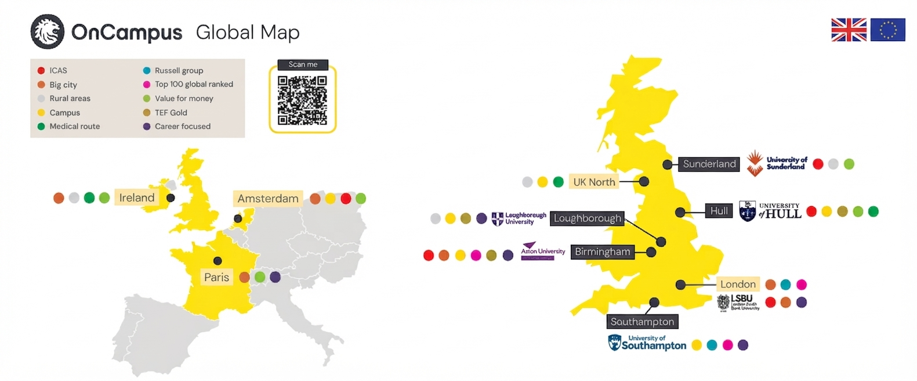
January 2027 | Portfolio at a glance
The supplied deck covers four recruitment routes across the UK.
CAS STRUCTURE
Integrated CAS
OnCampus Aston
OnCampus Hull
OnCampus Sunderland
OnCampus LSBU
January 2027
Intake focus
OnCampus | January 2027 Intake
02

Slide 3


CAS pathways
Integrated CAS routes — one visa covering the entire course duration.
Aston
Hull
UNDERGRADUATE ROUTES
ICAS / Integrated CAS
LSBU
OnCampus
Sunderland
English requirements are detailed separately for each Centre in the supplied deck.
OnCampus | January 2027 Intake
03

Slide 4

London South Bank University
OnCampus LSBU | UG ICAS
IY1 fees and entry requirements for January 2027.
IY1 • YEAR 1
After £5,500 scholarship
+ £450 registration
YEAR 2
After £5,000
scholarship
YEAR 3
Gross fee
£12,400
£12,500
PLACEMENT YEAR
Earn Up To 20,000
£17,500 each
REQUIREMENTS
QUICK REFERENCE
• IY1 GPA 2.3; 4-year Undergraduate GPA 2.0.
• Gap of 3 years accepted from 2023.
• Duolingo 105 minimum overall, with no section below 105.
• IELTS 5.5 with no less than 5.5; PTE 59 with no less than 59.
• No Maths required in Class 11/12 for Computer Science.
• English waiver: CBSE 65; other Indian boards 70 in English.
2.3 GPA
60% before CAS: £7,440
DET 105
IELTS 5.5 / PTE 59
Placement year available
OnCampus | January 2027 Intake
08

Slide 5

LSBU | iCAS degree progression
Degrees available to OnCampus students at LSBU
Undergraduate Foundation Programme (UFP)
International Year One (IY1)
• BA (Hons) Accounting and Finance
• BA (Hons) Architecture
• BA (Hons) Business Management
• BA (Hons) Business Management (Accounting)
• BA (Hons) Business Management (Finance)
• BA (Hons) Business Management (Marketing)
• BA (Hons) Marketing with Advertising and Digital Communications
• BEng (Hons) Building Services Engineering
• BEng (Hons) Chemical Engineering
• BEng (Hons) Civil Engineering
• BEng (Hons) Electrical and Electronic Engineering
• BEng (Hons) Electronic and Computer Systems Engineering
• BEng (Hons) Mechanical Engineering
• BSc (Hons) Architectural Technology
• BSc (Hons) Biomedical Science
• BSc (Hons) Building Surveying
• BSc (Hons) Commercial Management (Quantity Surveying)
• BSc (Hons) Computer Science
• BSc (Hons) Construction Management
• BSc (Hons) Economics
• BSc (Hons) Economics (Business Strategy)
• BSc (Hons) Economics (Finance)
• BSc (Hons) Engineering Product Design
• BSc (Hons) Forensic Science
• BSc (Hons) Information Technology
• BSc (Hons) Marketing with Digital
• BSc (Hons) Product Design
• BSc (Hons) Psychology
• BSc (Hons) Psychology (Clinical Psychology)
• BSc (Hons) Psychology (Forensic Psychology)
• MEng (Hons) Mechanical Engineering
• BA (Hons) Accounting and Finance
• BA (Hons) Business Management
• BA (Hons) Business Management (Accounting)
• BA (Hons) Business Management (Finance)
• BA (Hons) Business Management (Marketing)
• BA (Hons) Marketing with Advertising and Digital Communications
• BSc (Hons) Computer Science
• BSc (Hons) Computer Science (Artificial Intelligence)
• BSc (Hons) Computer Science (Cyber Security)
• BSc (Hons) Computer Science (Data Engineering)
• BSc (Hons) Economics
• BSc (Hons) Economics (Business Strategy)
• BSc (Hons) Economics (Finance)
• BSc (Hons) Information Technology
• BSc (Hons) Marketing with Digital
Degrees are subject to change. View the full list of degrees you can progress to here.
OnCampus | January 2027
09

Slide 6

OnCampus Aston | UG ICAS
Entry requirements, fees and progression information from the supplied January 2027 deck.
ENTRY REQUIREMENTS
IY1: GPA 2.4; 2.2–2.3 may apply subject to case approval and full fees.
4-year Undergraduate: GPA 2.0.
Math required for Accounting & Finance, Computer Science & Cybersecurity: C/4 in Year 12 or 60% in Year 11.
GAP of 3 years accepted from 2023.
English: Duolingo 100, IELTS 5.5, or PTE 59 (minimum scores as stated).
No pre-CAS interview; English waiver noted for overall B in Nepali Class 12, with short call, and 70 in English for Indian board.
For the placement year, students need to apply after successfully completing their second year of studies.
FEE SNAPSHOT
IY1 • Business
£13,460
after £6,500 scholarship
+ £450 registration = £13,910
£17,000
after £6,500 scholarship
+ £450 registration = £13,910
IY1 • Computer
£18,000–£19,000
after £4,500 scholarship
Year 2
Placement Year, Optional, Student earn up to £ 20,000 after 2nd Year and final year with Fee
Year 3
£22,500–£23,500
Computer / Business
OnCampus | January 2027 Intake
04

Slide 7
Aston | IY1 progression portfolio
International Year One programmes listed in the supplied deck.
International Year One (IY1)
BSc (Hons) Accounting and Finance
BSc (Hons) International Business and Management
BSc (Hons) Business and Management
BSc (Hons) Marketing
BSc (Hons) Computer Science
LLB (Hons) Law
BSc (Hons) Cybersecurity
Engineering IY1
Mechanical Engineering • Aerospace Engineering • Electrical & Electronic Engineering • Design Engineering • Electrical Engineering & Computer Science
Triple Crown University and 5 years of career support after graduation.
OnCampus | January 2027 Intake
05

Slide 8

OnCampus Hull | UG ICAS
Entry requirements and fee structure from the supplied January 2027 deck.
Year 1
Year 2
Year 3
IY1 FEES
£11,450
after £5,980 scholarship + £450 registration
£16,945 for Arts &
£ 19,520 for Science
after £2,000 scholarship
£16,945 for Arts &
£ 19,520 for Science
REQUIREMENTS
IY1 GPA 2.8; 4-year Undergraduate GPA 2.0.
Gap of 3 years accepted from 2023.
IELTS 5.5 with no less than 5.5; PTE 59 with no less than 59.
A Level General English C waiver.
Indian board English waiver: 70 in English in grade.
60% fee deposit before CAS: £6,870; remaining fee after enrolment before 2nd semester.
Placement Year is available for selected courses, such as BSc (Hons) Biomedical Science.
FULL-FEE PAYMENT
Paying full first-year fees adds a further £1,000 scholarship.
International Student fee link: www.hull.ac.uk/study/undergraduate/fees-and-funding
OnCampus | January 2027 Intake
06

Slide 9
HULL | IY1 progression portfolio
The supplied deck lists business, engineering and accounting/finance progression options.
International Year One (IY1)
• BA (Hons) Business Economics
• BEng (Hons) Biomedical Engineering
• BA (Hons) Business Management
• BEng (Hons) Chemical Engineering
• BA (Hons) Business Management and Accounting
• BEng (Hons) Electrical and Electronic Engineering
• BA (Hons) Business Management and Financial Management
• BEng (Hons) Mechanical Engineering
• BA (Hons) Business Management with Entrepreneurship
• BSc (Hons) Accounting
• BA (Hons) Business Management with Human Resource Management
• BSc (Hons) Accounting and Financial Management
• BA (Hons) Business Management with Logistics and Supply Chain
• BSc (Hons) Financial Management
• BA (Hons) Business Management with Marketing
• MEng (Hons) Biomedical Engineering
• BA (Hons) Economics
• MEng (Hons) Chemical Engineering
• BA (Hons) International Business
• MEng (Hons) Electrical and Electronic Engineering
• BA (Hons) Marketing and Management
• MEng (Hons) Mechanical Engineering
OnCampus | January 2027 Intake
07

Slide 10

OnCampus Sunderland | UG
IY1 fees and entry requirements from the supplied January 2027 deck.
IY1 • YEAR 1
Year 2 & 3 after £5,000 of scholarship
£11,450
Final tuition after £4,420 scholarship
(including £450 registration cost)
£12,500 each
REQUIREMENTS
• IY1 GPA 2.2; 4-year Undergraduate GPA 2.0.
• No pre-CAS interview.
• Gap of 3 years accepted from 2023.
• IELTS 5.5 with no less than 5.5; PTE 59 with no less than 59.
• English waiver on overall B in Class 12 Nepali board, subject to an OnCampus conversation-based English interview.
QUICK REFERENCE
2.2 GPA
No pre-CAS interview
3-year gap accepted
IELTS 5.5 / PTE 59
OnCampus | January 2027 Intake
08

Slide 11
Sunderland | IY1 progression portfolio
Four business-focused degree routes listed in the supplied deck.
International Year One (IY1)
BA (Hons) Accounting and Finance
BA (Hons) Business and Financial Management
BA (Hons) Business and Human Resource Management
BA (Hons) Business and Marketing Management
Business-focused IY1 portfolio
OnCampus | January 2027 Intake
09

Slide 12
Visa refusal cases
PAST
REFUSAL
USA
Australia
Canada
CASE-BY-CASE
REVIEW
OnCampus accepts students with past visa refusals from the USA, Australia and Canada.
OnCampus | January 2027 Intake
11

Slide 13
01
CAS route
JANUARY 2027
A clearer route to
the right programme.
02
Entry requirements
03
Fees & scholarships
Use the programme, fee and entry-requirement pages as the working reference for agent conversations.
04
Progression options
OnCampus | January 2027 Recruitment Reference

