Slide 1



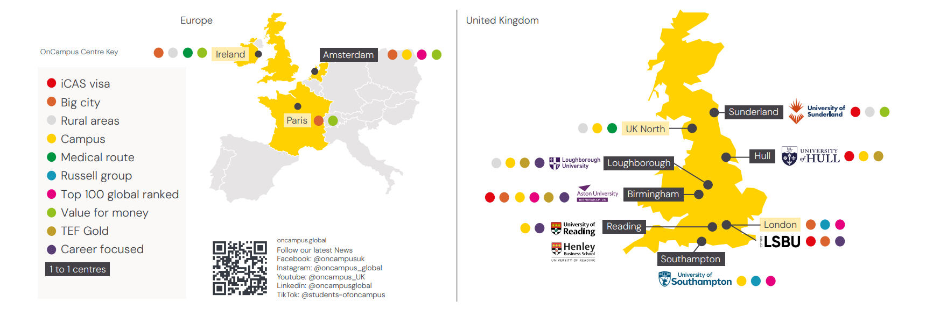
Global Map

Slide 2

ICAS Centers/
Integrated CAS (UG)
OnCampus LSBU
OnCampus Aston
OnCampus Sunderland
OnCampus Hull
English requirement center wise and ER from next page . . .

Slide 3
OnCampus LSBU UG
Fee IY1
1st Year: Gross Fee £ 17460 and £5,500 scholarship→ Final tuition fee: £11960 + 450 Registration cost = £ 12400 (After scholarship) (before CAS 60% fee deposit (£ 7440) before CAS and rest after enrollment before 2nd semester)
2nd Year: Gross Fee £ 17500 and £5,000 scholarship→ Final tuition fee: £12,500 (After scholarship)
3rd Year: Gross Fee £ 17500
Requirement:
Gpa 2.3 for International Year One (IY1) and 2.0 gpa for Undergraduate (4yrs)
GAP 3 years accepted from 2023
Duolingo English Test (DET) accepted — minimum overall score of 105, with no section below 105/
Ietls 5.5 no less than 5.5 and Pte 59 no less than 59
No Math subject required in class 11/12 for Computer Science.
English Waiver for Indian Board CBSE Board 65 and rest Indian board 70 in English in grade
Subject Majorly = Business and Computer for sept 26

Slide 4
OnCampus Hull UG
Fee IY1
1st Year: Gross Fee £16980 and £5,980 scholarship→ Final tuition fee: £11450 (After scholarship and including registration cost of 450 pounds) (before CAS 60% fee deposit (£ 6870) before CAS and rest after enrollment before 2nd semester)
1st year if you pay full fees £1000 additional scholarship will be added.
2nd Year: Gross Fee £18000 and £2,000 scholarship→ Final tuition fee: £16,000 (After scholarship)
3rd Year £2,000 scholarship : Gross Fee £18000 = £16,000 (After scholarship)
Requirement:
Gpa 2.6 for International Year One (IY1) and 2.0 gpa for Undergraduate (4yrs)
GAP 3 years accepted from 2023
Ietls 5.5 no less than 5.5 and Pte 59 no less than 59
As Level General English C waiver
English Waiver for Indian board 70 in English in grade
Adult Nursing subject icas (Joint CAS) 4years foundation program and 4 placement year during study and every year 5000 pouds scholarship for Nursing

Slide 5
OnCampus Hull UG Adult Nursing
Fee UFP (Foundation)
1st Year: Gross Fee £17970 and £6980 scholarship→ Final tuition fee: £11430 (After scholarship and including registration cost of 450 pounds) (before CAS 60% fee deposit (£ 6858) before CAS and rest after enrollment before 2nd semester)
2nd Year: Gross fee is £20,600 – includes a £2,000 ONCAMPUS scholarship and £5,000 NHS funding. Note: The NHS funding is like a loan, but it usually does not need to be paid back = £13600
3rd Year: Gross fee is £20,600 – includes a £2,000 ONCAMPUS scholarship and £5,000 NHS funding. Note: The NHS funding is like a loan, but it usually does not need to be paid back = £13600
4th Year: Gross fee is £20,600 – includes a £2,000 ONCAMPUS scholarship and £5,000 NHS funding. Note: The NHS funding is like a loan, but it usually does not need to be paid back = £13600
Requirement:2.0 gpa for Undergraduate (4yrs)
GAP 3 years accepted from 2023 IETLS 5.5 no less than 5.5 and Pte 59 no less than 59 for foundation year only but need IETLS 7 no less than 6.5 for University of Hull progression.
As Level General English C waiver English Waiver for Indian board 70 in English in grade

Slide 6
OnCampus Aston UG
Fee for IY1
ER Gpa 2.8 (2.5 gpa onwards can also apply case to approval) for International Year One (IY1) and 2.0 gpa for Undergraduate (4yrs)
1st Year: Gross Fee £ 19960 and £6,500 scholarship→ Final tuition fee: £13460 + £ 450 Registration cost = £13910 (After scholarship) (before CAS 60% fee deposit (£ 8346) before CAS and rest after enrollment before 2nd semester)
2nd Year: : Gross Fee £ 22000 and £4500 scholarship→ Final tuition fee: £17,500 (After scholarship)
3rd Year : £22,500
Or Placement option
2nd Year: £4500 scholarship→ Final tuition fee: £17,500 (After scholarship) and apply for Placement year
3rd Year earn 18k to 19k pounds and pay 2500 pounds only fee for placement no education fees.
4th year Full fees 22500 pounds
Requirement:
GAP 3 years accepted from 2023 and Duolingo English Test = score of 100 no less then100 and Ietls 5.5 no less than 5.5 and Pte 59 no less than 59
English waiver on overall B in class 12 Nepali board and for Indian board 70 in English in grade
Triple Crown University and 5 years of career support after graduation.

Slide 7
OnCampus Sunderland UG
Fee IY1
1st Year: Gross Fee £15420 and £4,420 scholarship→ Final tuition fee: £11450 (After scholarship) and (After scholarship and including registration cost of 450 pounds)
2nd Year: Gross Fee £17500 and £5,000 scholarship→ Final tuition fee: £12500 (After scholarship)
3rd Year: Gross Fee £17500 and £5,000 scholarship : £12,500 (After scholarship)
Requirement:
Gpa 2.2 for International Year One (IY1) and 2.0 gpa for Undergraduate (4yrs)
No pre CAS interview
GAP 3 years accepted from 2023
Ietls 5.5 no less than 5.5 and Pte 59 no less than 59
English waiver on overall B in class 12 Nepali board (English Interview with OnCampus conversation based has to be passed to get English waiver)

Slide 8
Visa Refusal cases
We accept students with past visa refusals from the USA, and also Australia, and Canada

